Slide 1
Day 2 FDP on Data Science Classification

Slide 3
Logistic Regression
Logistic regression Supervised Machine Learning algorithms.
It is used for predicting the categorical dependent variable using a given set of independent variables.
The outcome must be a categorical or discrete value. It can be either Yes or No, 0 or 1, true or False, etc. but instead of giving the exact value as 0 and 1, it gives the probabilistic values which lie between 0 and 1.
Logistic Regression is much similar to the Linear Regression except that how they are used. Linear Regression is used for solving Regression problems, whereas Logistic regression is used for solving the classification problems.
In Logistic regression, instead of fitting a regression line, we fit an "S" shaped logistic function, which predicts two maximum values (0 or 1).

Slide 4
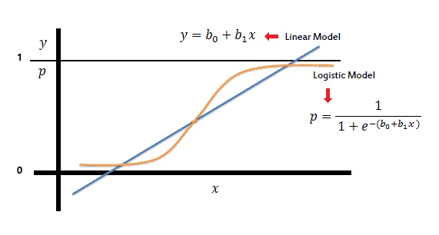
Logistic Function (Sigmoid Function):
The sigmoid function is a mathematical function used to map the predicted values to probabilities.
It maps any real value into another value within a range of 0 and 1.
Curve like the "S" form. The S-form curve is called the Sigmoid function or the logistic function.

Slide 5
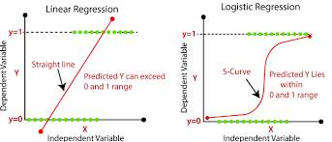
Linear Regression vs Logistic regression

Slide 6
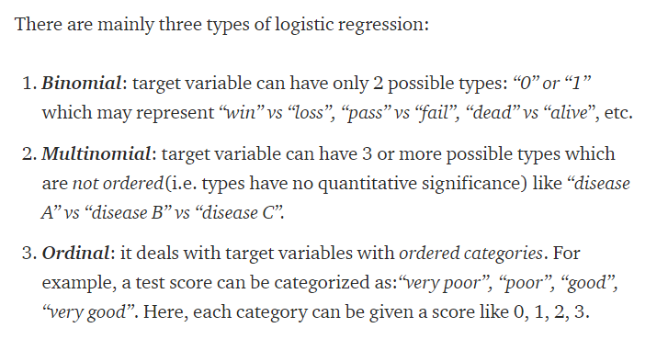
Types of Logistic Regression

Slide 7
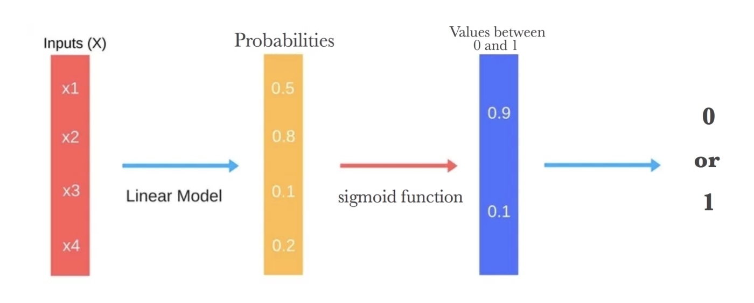
Flow sequence of Logistic Regression

Slide 8
Terminologies involved in Logistic Regression:
Logistic function: The formula used to represent how the independent and dependent variables relate to one another. The logistic function transforms the input variables into a probability value between 0 and 1, which represents the likelihood of the dependent variable being 1 or 0.
Odds: The proportion of an event’s chances of happening to its chances of not happening. The chances are used in logistic regression to model the connection between the independent and dependent variables.
Log-odds: The logistic regression model’s calculation is made simpler by using the logarithm of the odds.
Coefficient: The logistic regression model’s estimated parameters, which show how the independent and dependent variables relate to one another.
Intercept: A constant term in the logistic regression model, which represents the log-odds when all independent variables are equal to zero.
Maximum likelihood estimation: The method used to estimate the coefficients of the logistic regression model, which maximizes the likelihood of observing the data given the model.

Slide 9
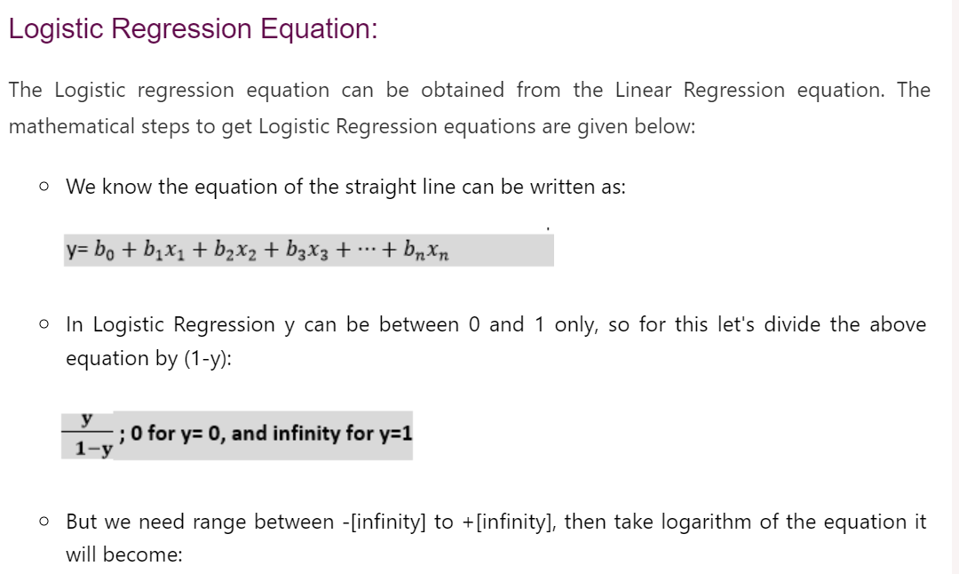
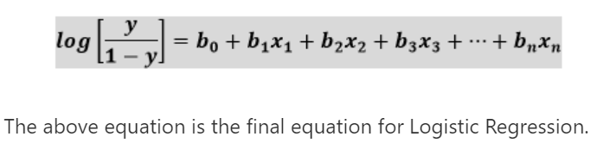

Slide 10
K-NN Classifier

Slide 11
KNN Classifier
K-nearest neighbours (KNN) algorithm is a type of supervised ML algorithm.
It is used for both classification as well as regression predictive problems.
The following two properties would define KNN well
Lazy learning algorithm − KNN is a lazy learning algorithm because it does not have a specialized training phase and uses all the data for training while classification.
Non-parametric learning algorithm − KNN is also a non-parametric learning algorithm because it doesn’t assume anything about the underlying data.

Slide 12
K-NN Classifier
Types of Learners In Classification
Lazy Learners :
Lazy learners simply store the training data and wait until a testing data appears.
The classification is done using the most related data in the stored training data.
They take more predicting time compared to eager learners.
Eg – k-nearest neighbour, case-based reasoning.
Eager Learners :
Eager learners construct a classification model based on the given training data before getting data for predictions.
It must be able to commit to a single hypothesis that will work for the entire space.
Due to this, they take a lot of time in training and less time for a prediction.
Eg– Decision Tree, Naive Bayes, Artificial Neural Networks.

Slide 13
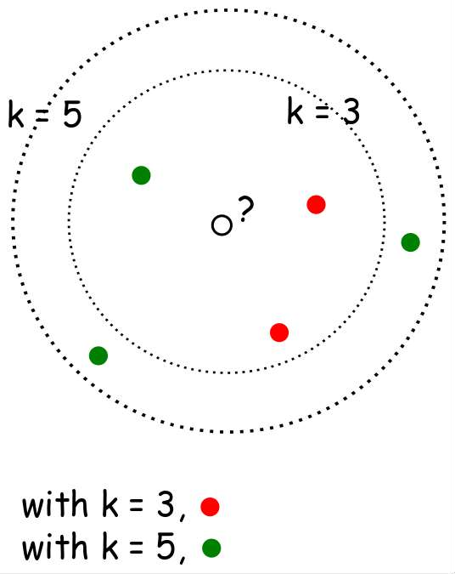
What is k- NN??
When k=3 or k=5??
Nearest-neighbor classifiers are based on learning by analogy, that is, by comparing a given test tuple with training tuples that are similar to it.
The training tuples are described by n attributes.
When k = 1, the unknown tuple is assigned the class of the training tuple that is closest to it in pattern space.

Slide 14
Distance Measures
𝐸𝑢𝑐𝑙𝑖𝑑𝑒𝑎𝑛 𝑑𝑖𝑠𝑡𝑎𝑛𝑐𝑒 ∶ 𝑑 𝑥, 𝑦
= ∑ 𝑥_{𝑖} − 𝑦𝑖
2
𝑆𝑞𝑢𝑎𝑟𝑒𝑑 𝐸𝑢𝑐𝑙𝑖𝑑𝑒𝑎𝑛 𝑑𝑖𝑠𝑡𝑎𝑛𝑐𝑒 ∶ 𝑑 𝑥, 𝑦
= ∑ 𝑥_{𝑖} − 𝑦𝑖
2
𝑀𝑎𝑛ℎ𝑎𝑡𝑡𝑎𝑛 𝑑𝑖𝑠𝑡𝑎𝑛𝑐𝑒 ∶ 𝑑 𝑥, 𝑦
= ∑ |(𝑥𝑖 − 𝑦𝑖)|
Which distance measure to use?
We use Euclidean Distance as it treats each feature as equally important.

Slide 15
How to choose K?
If infinite number of samples available, the larger is k, the better is classification.
k = 1 is often used for efficiency, but sensitive to “noise”
Larger k gives smoother boundaries, better for generalization, but only if locality is preserved. Locality is not preserved if end up looking at samples too far away, not from the same class.
Interesting relation to find k for large sample data :
k = sqrt(n)/2 where n is # of examples

Slide 16
K-NN Algorithm
KNN working with the help of following steps :
Step 1 − Load the training as well as test data.
Step 2 − Choose the value of K i.e. the nearest data points. K can be any integer.
Step 3 − For each point in the test data do the following −
3.1 − Calculate the distance between test data and each row of training data with the help of any of the method namely: Euclidean, Manhattan or Hamming distance. The most commonly used method to calculate distance is Euclidean.
3.2 − Now, based on the distance value, sort them in ascending order.
3.3 − Next, it will choose the top K rows from the sorted array.
3.4 − Now, it will assign a class to the test point based on most frequent class of these rows.
Step 4 − End

Slide 17
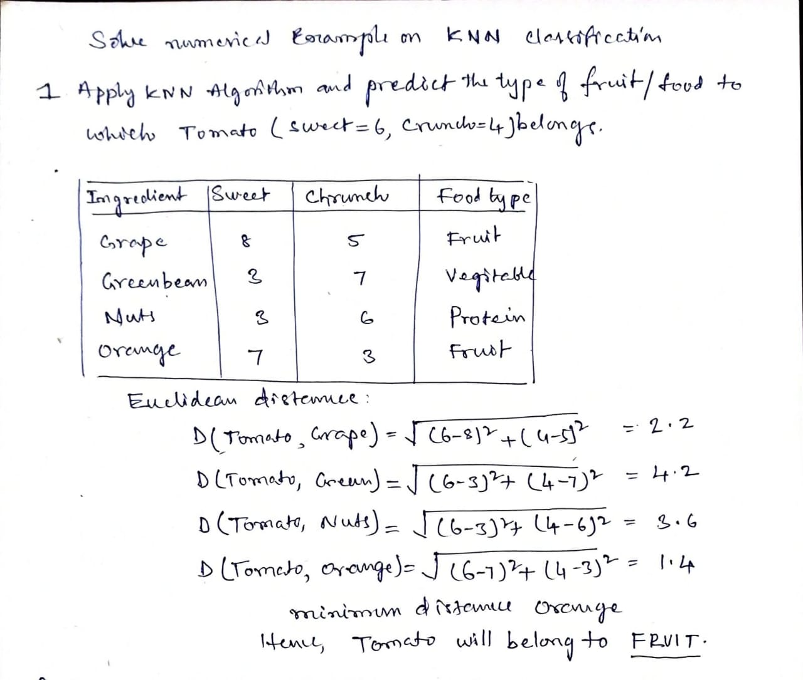
Example

Slide 18
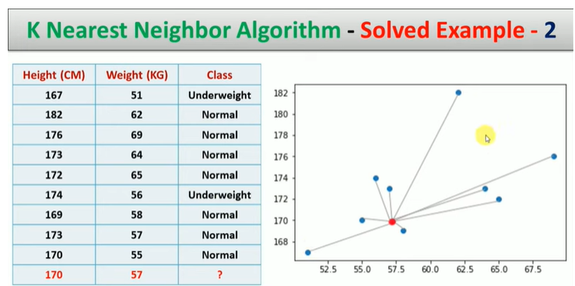
Example

Slide 19
Complexity?
O(d) to compute distance to one examples
O(nd) to computed distances to all examples
Plus O(nk) time to find k closest examples
Total time: O(nk+nd)
Very expensive for a large number of samples
But we need a large number of samples for kNN to to work well!!

Slide 20

Support Vector Machine

Slide 21
Support Vector Machine

Slide 22
Support Vector Machine-Types
Linear SVM
Non-linear SVM:

Slide 23
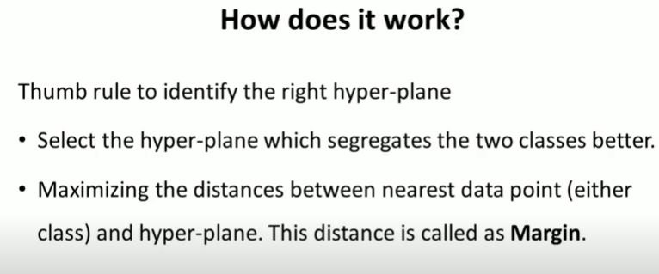
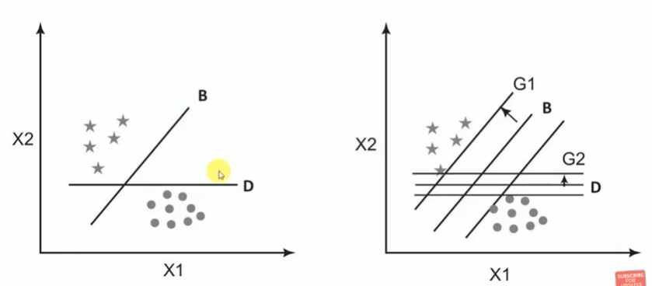
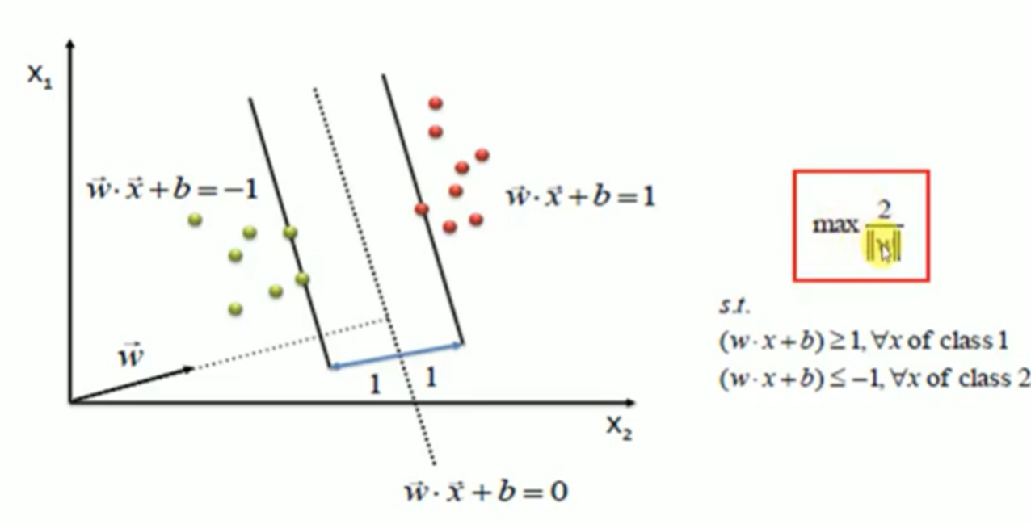
SVM How it works?

Slide 24
SVM Model

Slide 25
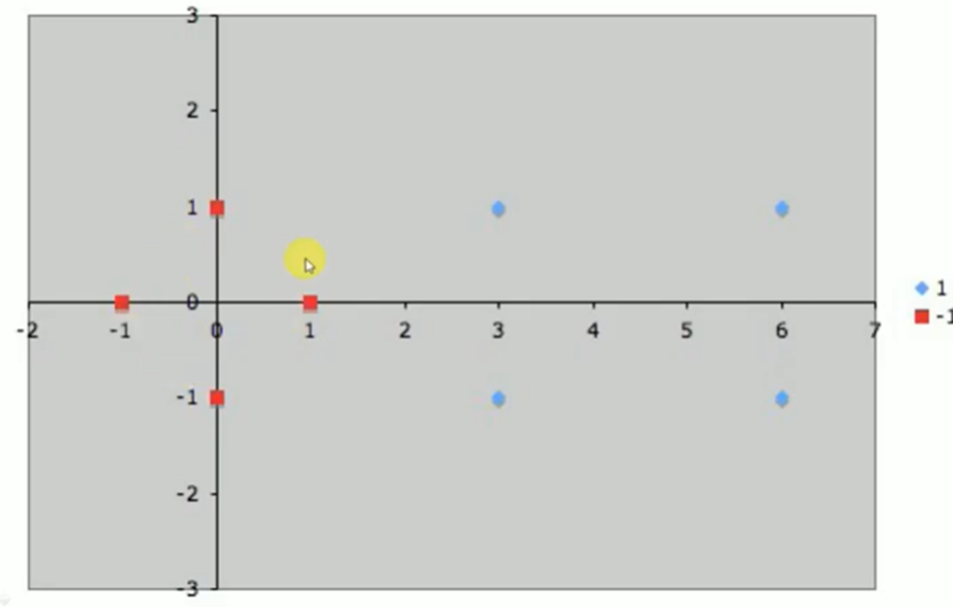
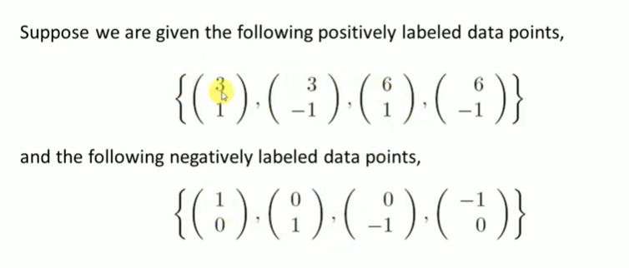
Example: Design a Linear SVM model with the following dataset to classify positive or Negatively labelled

Slide 26
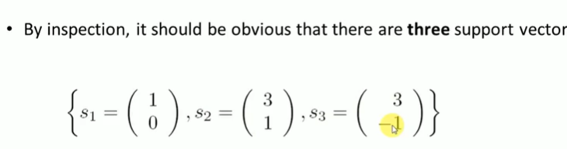
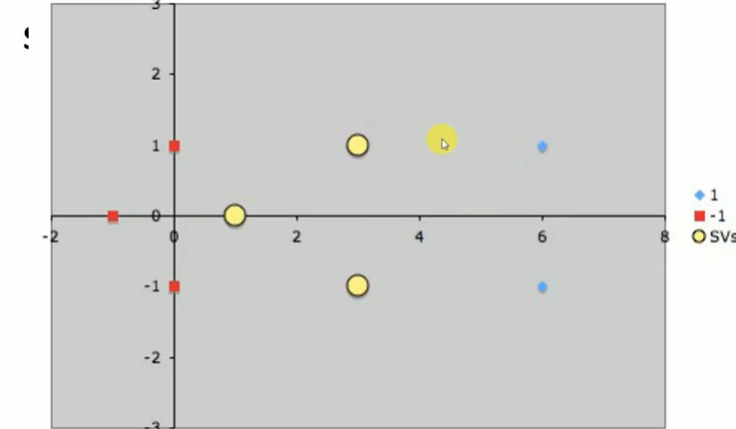
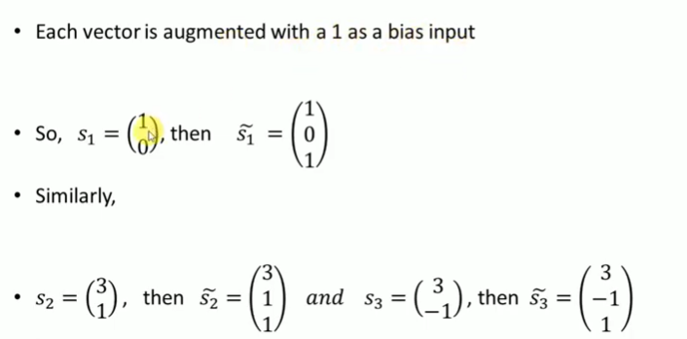
Example

Slide 27
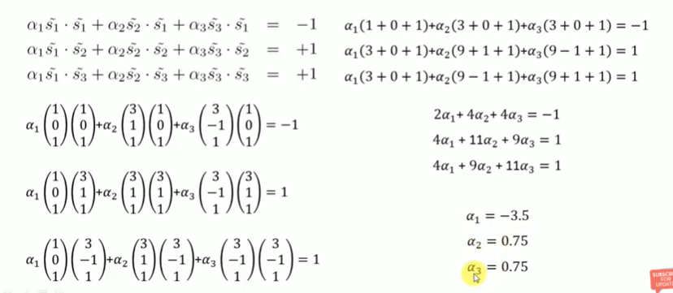
Example

Slide 28
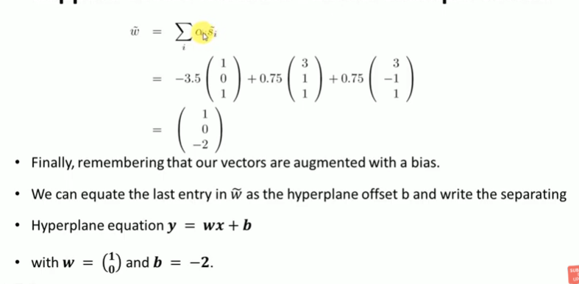
Example:

Slide 29
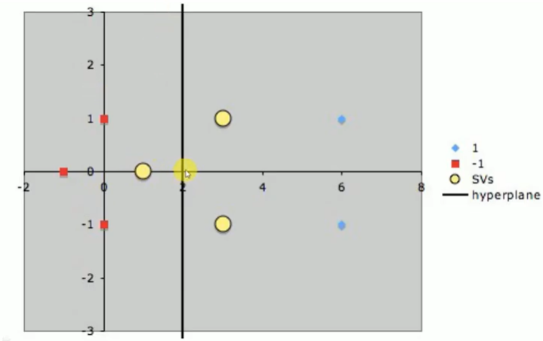
Example:

Slide 30
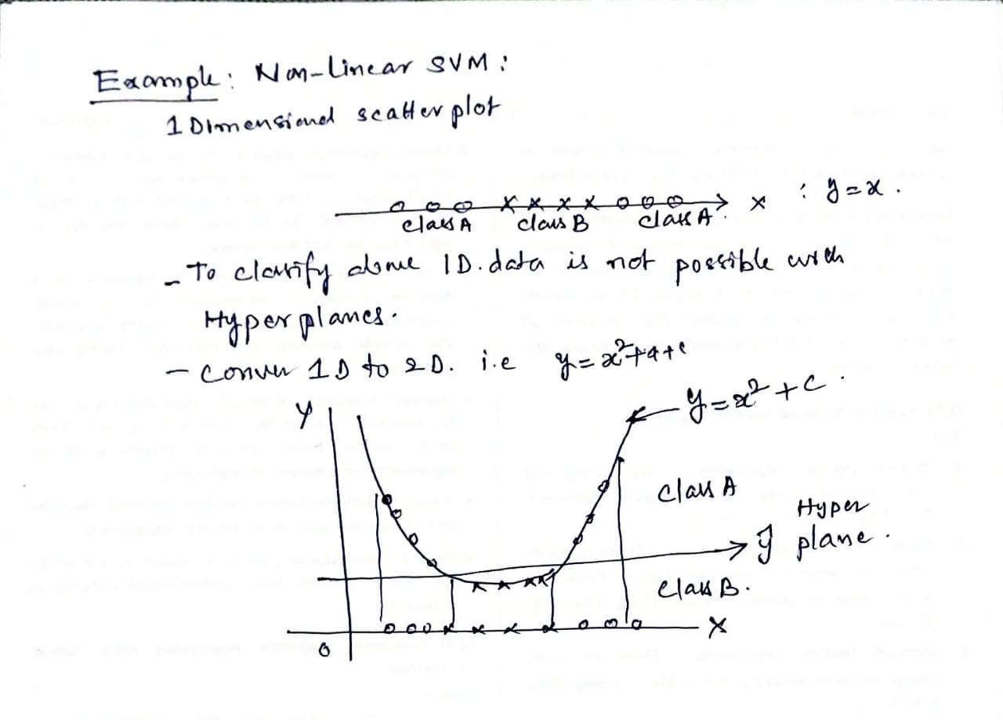
Non-Linear SVM : Example 1

Slide 31
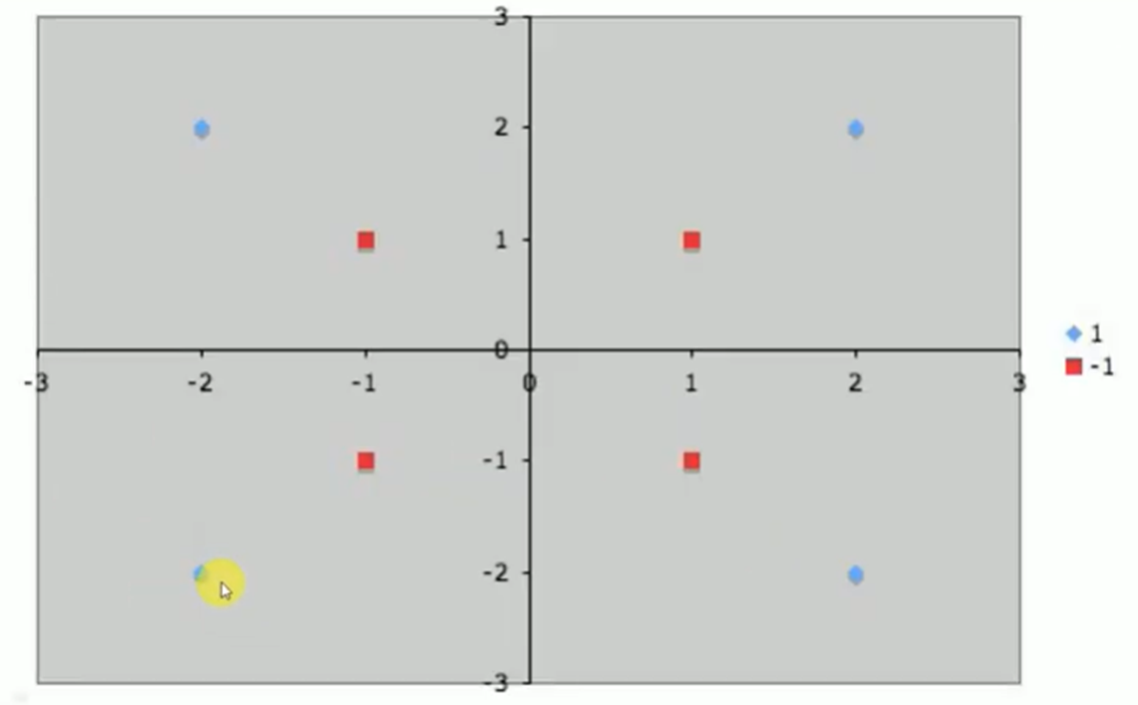
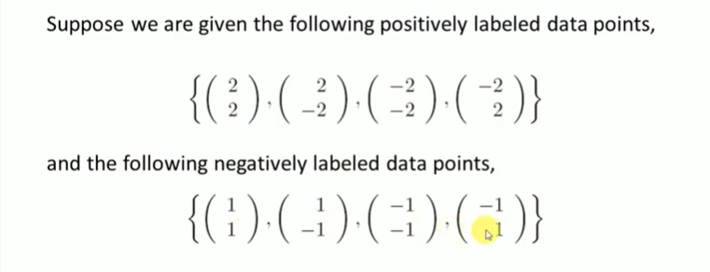
Example 2:
Design a Non-Linear SVM to classify Blue or Red classes with given data

Slide 32
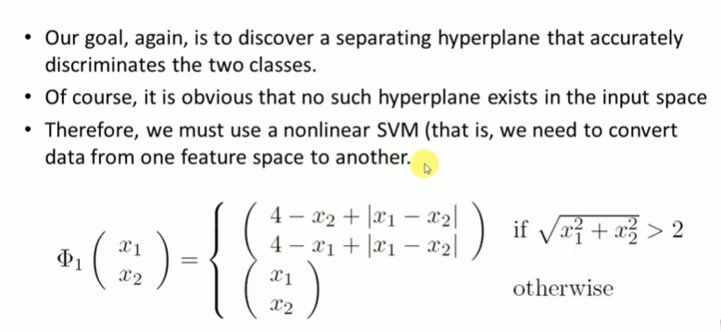
Example

Slide 33
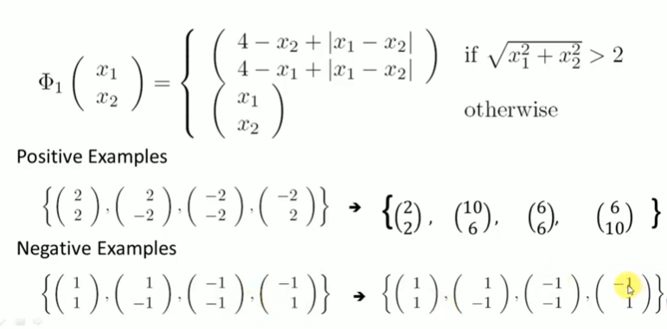
Example

Slide 34
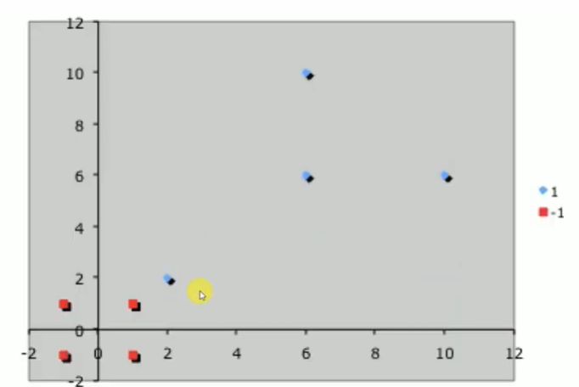
Example

Slide 35
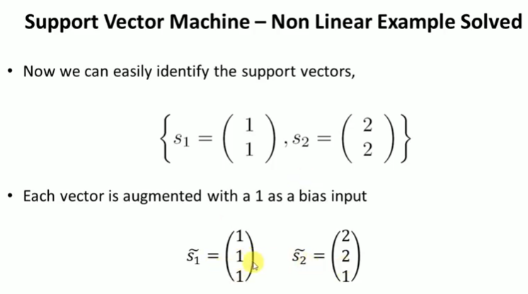
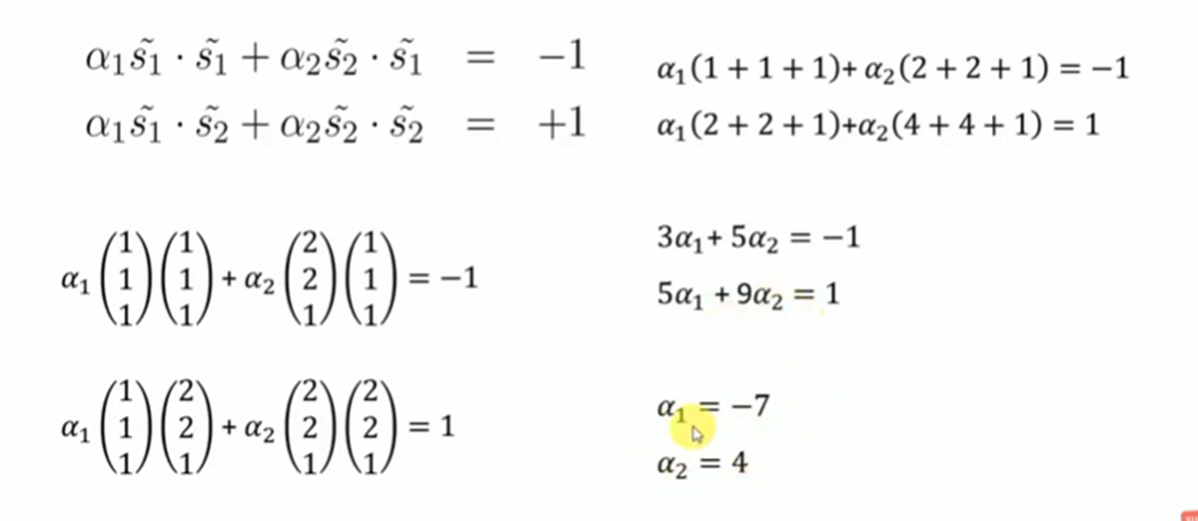
Example

Slide 36
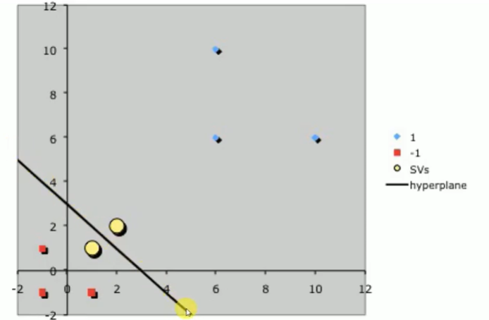
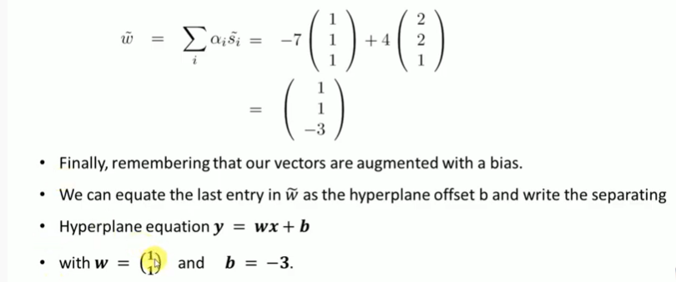
Example

Slide 37
Ensemble Algorithms: Random forest

Slide 38
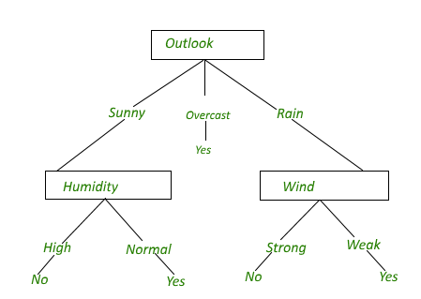
Decision tree: Its issues?
Overfitting the data: High variance, low bias

Slide 39
Why Random forest?
Random reduces high variance in the Decision tree.
A Random forest is an ensemble learning method where multiple decision trees are constructed, trained by the Bagging method and then they are merged to get a more accurate prediction.

Slide 40
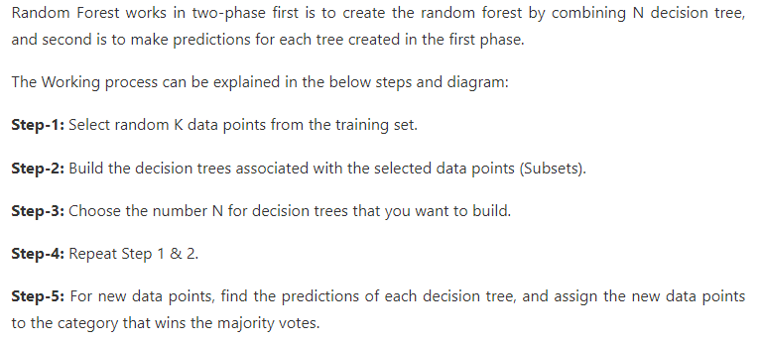
Random Forest

Slide 41
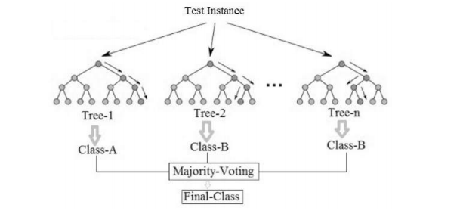
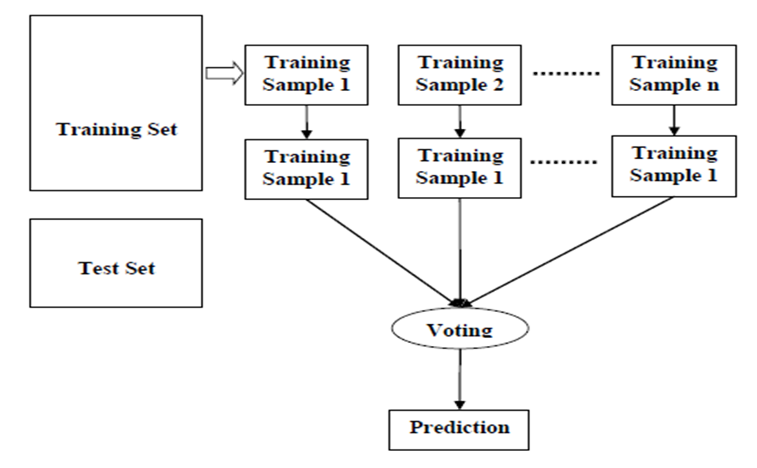
Example of random forest with majority voting

Slide 42
Ensemble Algorithms
These algorithms combines the decisions from multiple models to improve the overall performance.
This approach allows the production of better predictive performance compared to a single model.
Advantage : Improvement in predictive accuracy. Disadvantage : It is difficult to understand an ensemble of classifiers.
Basic Ensemble Techniques Max Voting, Averaging, Weighted Average
2. Advanced Ensemble Techniques Stacking, Blending, Bagging, Boosting
3. Algorithms based on Bagging and Boosting Bagging : Bagging meta-estimator Random Forest Boosting: AdaBoost ,GBM, XGB, Light GBM, CatBoost

Slide 43
Why do ensembles work?
It address the following problems
Statistical Problem The Computational Problem arises when the learning algorithm cannot guarantees finding the best hypothesis.
Representational Problem The Representational Problem arises when the hypothesis space does not contain any good approximation of the target class(es).

Slide 44
Types of ensemble method
There are many ensemble techniques available, but we will discuss about the below two most widely used methods:
1. Bagging
2. Boosting
Let us first understand the similarities and differences between both terminologies.
Both the methods can be used for classification (discrete output) and regression (continuous output) problems.
­Both methods are better in performance compared to single models as they aggregate the output of all the weak learners via voting thereby leading to more accuracy in the predictions.

Slide 45
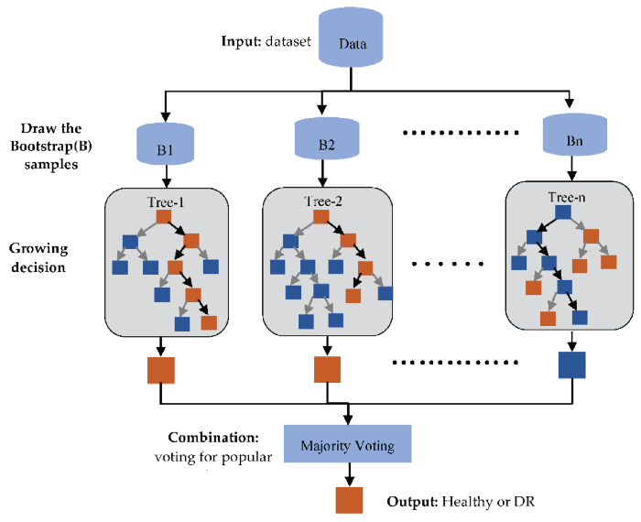
Implementation steps of Bagging(Bootstrap)
Multiple subsets are created from the original data set with equal tuples, selecting observations with replacement.(Row sampling replacement)
A base model is created on each of these subsets.
Each model is learned in parallel from each training set and independent of each other.
The final predictions are determined by combining the predictions from all the models. Classify by majority voting

Slide 46
Boosting
The idea of Boosting method is that instead of using a simple algorithm, which is not strong enough to make the accurate predictions alone as there are high variance and error rate, we combine multiple simple learning algorithms together, rather than finding a single highly accurate prediction rule.
The Boosting algorithm then combines these multiple weak rules together to reduce variance and bias in individual model rules into a single prediction rule, such that it will be much more accurate than any one of the weak rules as.

Slide 47
Boosting
Two fundamental approaches for effective implementation of Boosting algorithm:
Choosing the different subsets from training dataset for different iterations:
To increase the efficiency of the base learner predictions, high weightage is placed on the examples that were misclassified by earlier weak learner.
How to combine weak leaners together:
Taking a weighted majority vote of the predictions.

Slide 48
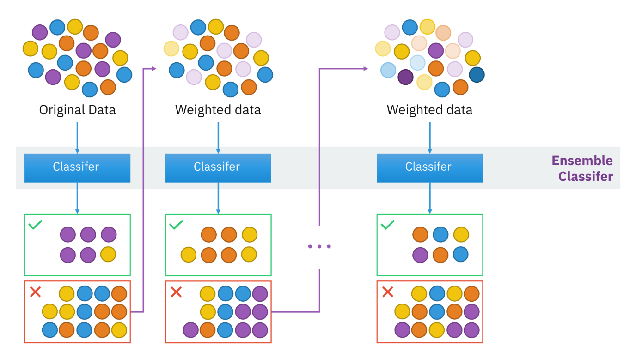
Boosting

Slide 49
Boosting Algorithm
Step 1: All observations have equal weight in the original training data set D₁. An initial “base” classifier h₁ is determined.
Step 2: The observations that were incorrectly classified by the previous base classifier have their weights increased, while the observations that were correctly classified have their weights decreased.
This gives us data distribution D_{m}, m=2, … , M.
A new base classifier hm, m = 2, … , M is determined, based on the new weights. This step is repeated until the desired number of iterations M is achieved.
Step 3: The final boosted classifier is the weighted sum of the M base classifiers

Slide 50
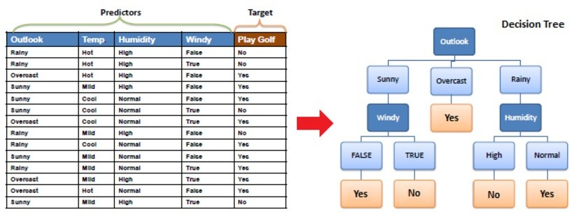
A simple example

Slide 51
Principled Criterion
●
●
Choosing the most useful attribute for classifying examples. Entropy
-
-
A measure of homogeneity of the set of examples
If the sample is completely homogeneous the entropy is zero and if the sample is an equally divided it has entropy of one
●
Information Gain
-
Measures how well a given attribute separates the training examples according to their target classification
This measure is used to select among the candidate attributes at each step while growing the tree
-

Slide 52
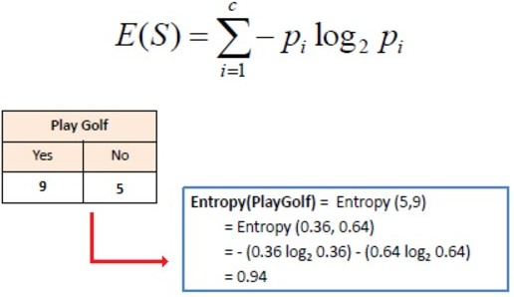
Information Gain
Step 1 : Calculate entropy of the target

Slide 53
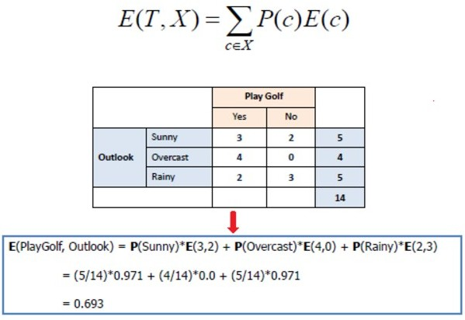
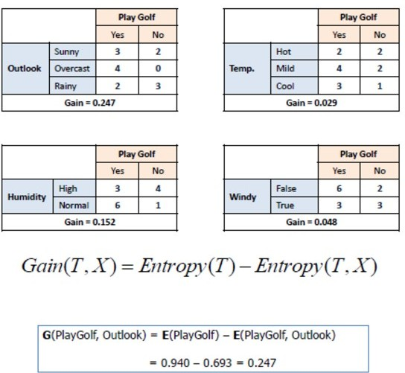
Information Gain (Cont’d)
Step 2 : Calculate information gain for each attribute

Slide 54
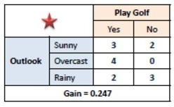
Information Gain (Cont’d)
Step 3: Choose attribute with the largest information gain as the decision node.

Slide 55
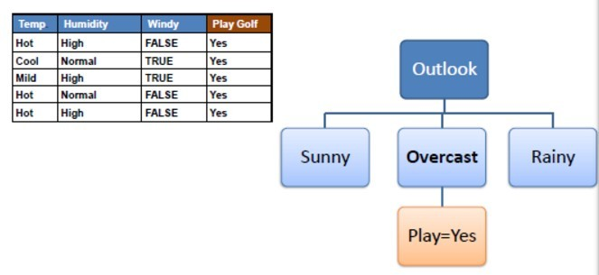
Information Gain (Cont’d)
Step 4a: A branch with entropy of 0 is a leaf node.

Slide 56
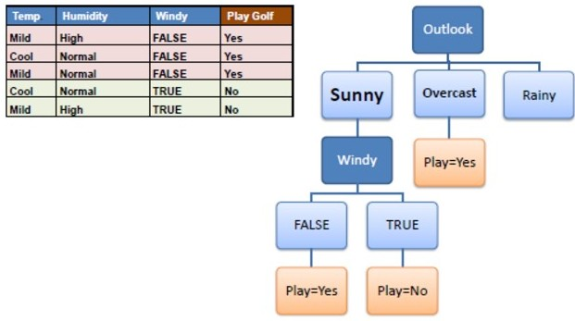
Information Gain (Cont’d)
Step 4b: A branch with entropy more than 0 needs further splitting.
Step 5: The algorithm is run recursively on the non-leaf branches, until all data is classified.

Slide 57

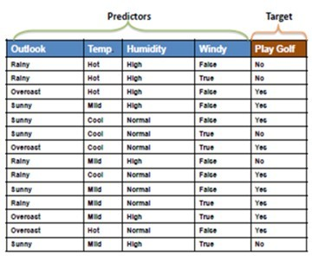
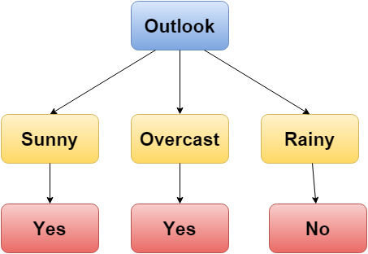
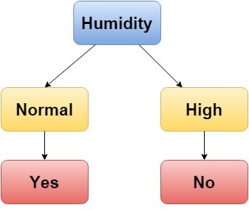

Decision Tree & Random Forest
Decision Tree
Random Forest
Tree 1
Tree 2
14
Tree 3

Slide 58
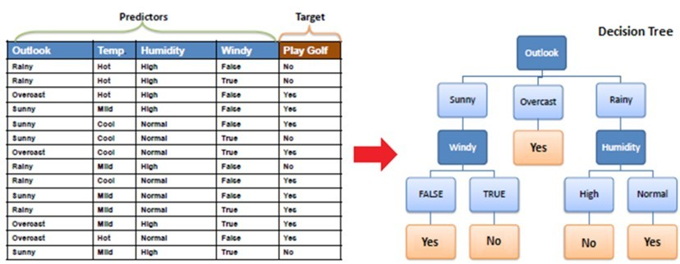
Decision Tree
Outlook | Temp. | Humidity | Windy | Play Golf
Rainy | Mild | High | False | ?
Result : No

Slide 59
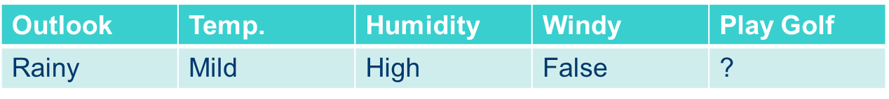
Random Forest
Tree 1 : No Tree 2 : No Tree 3 : Yes
Tree 1
Tree 2
Yes : 1
No : 2
Result : No
Tree 3

Slide 60
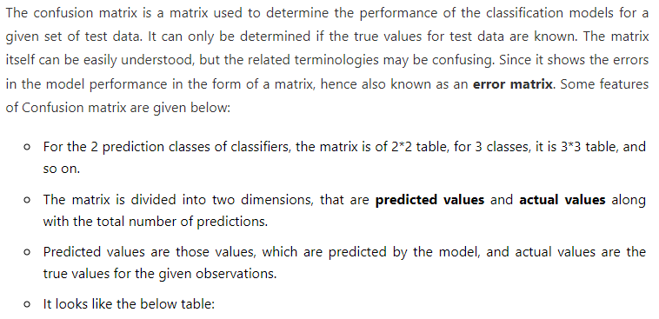
Performance Measures of the Classification Models

Slide 61
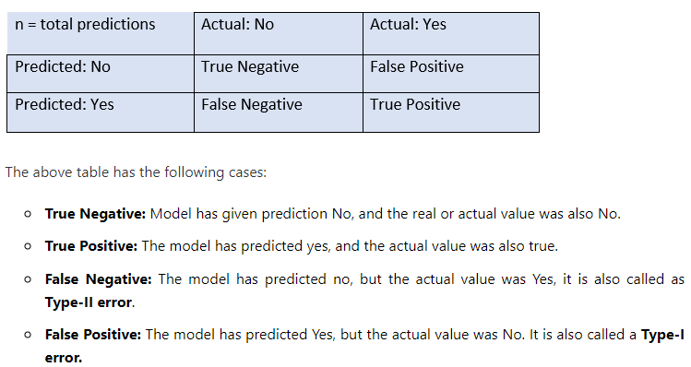

Slide 62


Slide 63


Slide 64


Slide 65


Slide 66


Slide 67


ROC Curve(receiver operating characteristic curve)

Slide 68


Slide 69


